Slide 1







































2024 CAGC Summit and Expo
Copy/paste any of the icons below into your presentation. Please change color to white if using them on a dark background.
Lamar Sylvester, PE
Chief Engineer
August 2, 2023

Slide 2
Looking Back at FY 2024

Slide 3
FY 24 Let Construction Contracts
483 let construction contracts in FY 24
  100 Centrally let contracts (greater than $5M or specialty contract)
  383 Division let contracts (less than $5M)
Total Value of Let Contracts: $3.92B
  $3.25B Centrally Let Projects
  0.67B Division Let Projects
439 Contracts Accepted in FY 2024
  84 Central Let Contracts Accepted (2 DB, 18 Other, 45 Resurfacing, 19 Bridge)
  355 Division Let Contracts Accepted (1 DB, 142 Other, 147 Resurfacing, 65 Bridge)
FY 24 Projects Accepted

Slide 4
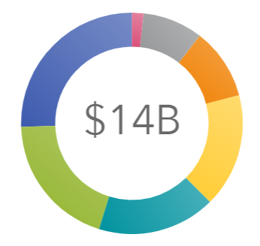
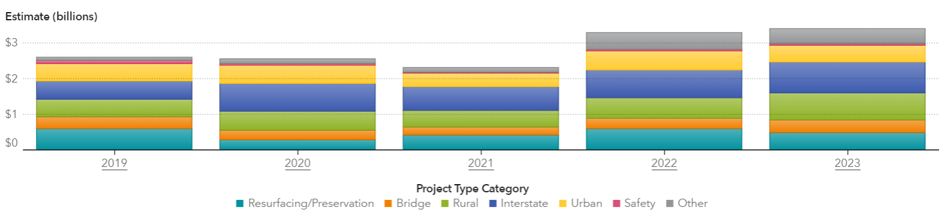
Estimates by Project Type
CY 2019-2023

Slide 5
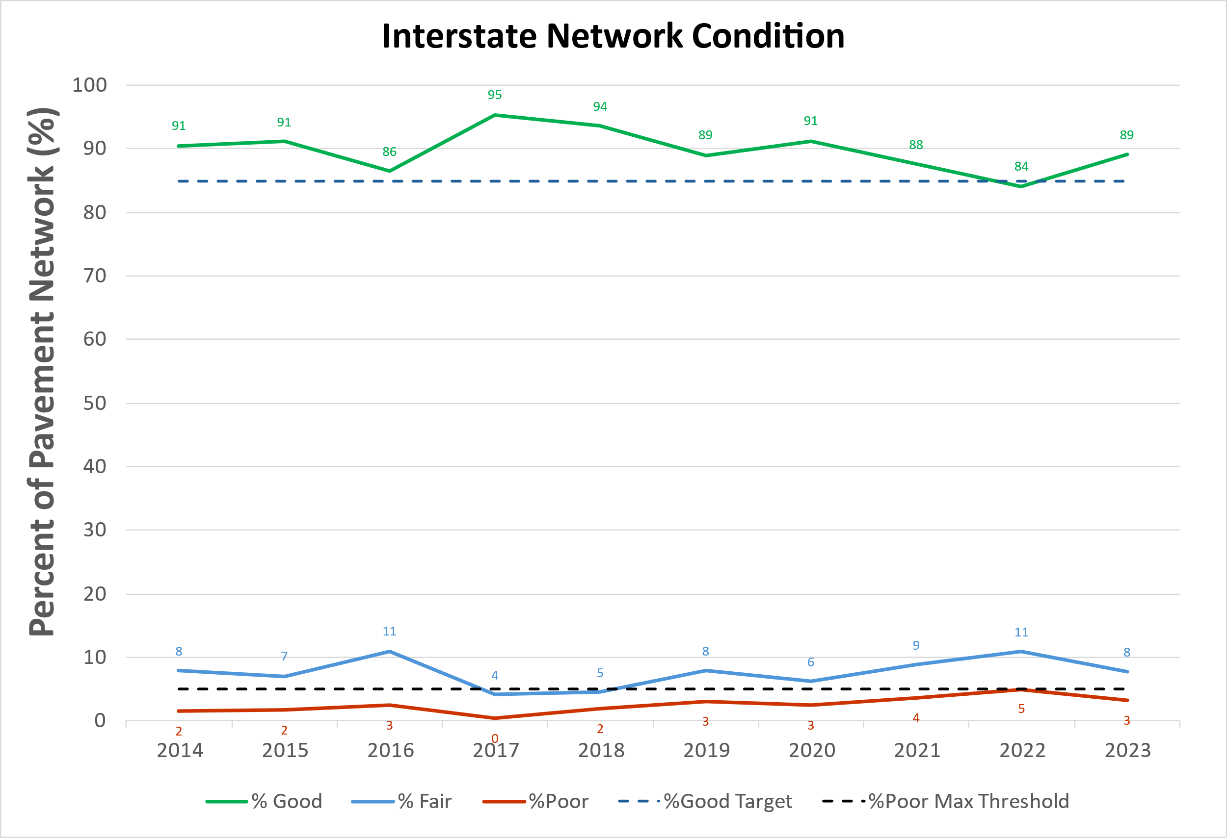
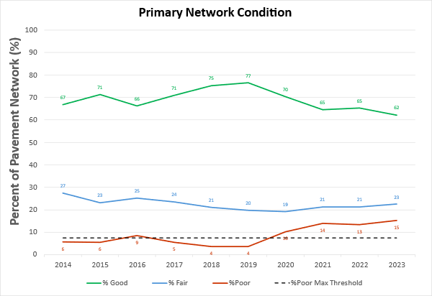
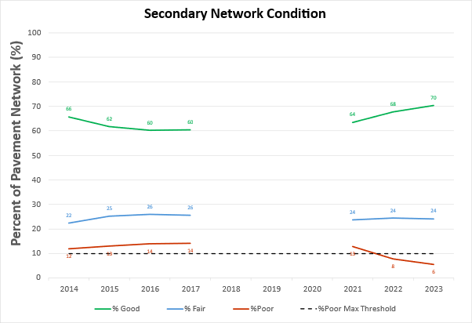
FY 24 Contract Resurfacing and Pavement Preservation Totals
FY 24 Contract Pavement Accomplishments

Slide 6
Condition Trend Totals
Bridge Accomplishments
Notes:
149 New/Bridges Replaced – these are bridges that Structures Management inspected and brought onto the system during calendar year 2023.

Slide 7
Maintenance Function Totals
FY 24 Maintenance Function Accomplishments
Functional Category | FY 2023 Contract $ | FY 2024 Contract $
ADMIN FIELD | 8,865,999 | 11,543,898
BRIDGE | 9,790,737 | 12,221,136
MAINTENANCE | 58,682,052 | 66,997,967
MISCELLANEOUS | 7,793,150 | 8,906,769
PAVEMENT | 18,544,160 | 17,549,999
ROADSIDE | 13,489,333 | 11,484,594
TRAFFIC | 25,533,931 | 25,553,452
Total | 142,699,361 | 154,257,814
Work Accomplished Sample
Quantity | Work
71,000 | LFT barrier rail installed/repaired.
6,300 | LFT small pipe installed
7,000 | SHM shoulder/ditch maintenance
100,000 | TON of asphalt work
1,700,000 | LFT longline striping
2,200 | SHM mechanical brush/tree
65,000 | SQF manual brush/tree
*GMR contract work functions only
Notes:
General Maintenance Reserve only.
Contract functions only.
Only dollars can be aggregated up together (blue table)
A sample of higher value and common work accomplished (orange table)
SHM shoulder/ditch and TON of asphalt work both contain multiple function codes aggregated together (3112C, 3108C, 3109C and 2818C, 2817C, 2812C, 2814C, respectively)

Slide 8
Active Construction Contracts
759 active construction contracts
  278 Centrally let contracts (greater than $5M or specialty contract)
  481 Division let contracts (less than $5M)
Total Value of Active Contracts: $14B
  $13.09B Centrally Let Projects
  0.90B Division Let Projects
CY 2023 Payments: $3.46B
CY 2024 To Date: $1.52B

Slide 9
Looking Forward to FY25

Slide 10
 | Aug-24 | Sep-24 | Oct-24 | Nov-24 | Dec-24 | Jan-25 | Feb-25 | Mar-25 | Apr-25 | May-25 | Jun-25 | Jul-25 | Totals
TIP Bridge Replacement | $17 | $7 |  | $9 | $51 | $28 | $16 | $14 | $19 | $32 | $136 | $56 | $385
TIP Projects | $26 | $60 | $309 | $44 | $223 | $41 | $118 | $100 | $150 | $174 | $201 | $486 | $1,932
Bridge Preservation | $2 |  |  | $9 |  | $10 | $11 | $5 | $2 | $3 | $3 | $4 | $49
Design Build |  |  |  |  |  |  |  |  |  |  | $426 |  | $426
Rail |  |  | $24 |  |  |  |  |  |  |  | $56 | $96 | $176
Total Accumulation | $45 | $112 | $445 | $507 | $781 | $860 | $1,005 | $1,124 | $1,295 | $1,504 | $2,326 | $2,968

Slide 11
 | Aug-24 | Sep-24 | Oct-24 | Nov-24 | Dec-24 | Jan-25 | Feb-25 | Mar-25 | Apr-25 | May-25 | Jun-25 | Jul-25
TIP Bridge Replacement | 2 | 1 |  | 1 | 5 | 2 | 2 | 2 | 2 | 4 | 8 | 1
TIP Projects | 1 | 3 | 5 | 2 | 9 | 3 | 7 | 3 | 6 | 6 | 12 | 10
Bridge Preservation | 1 |  |  | 2 |  | 1 | 2 | 1 | 1 | 1 | 1 | 2
Design Build |  |  |  |  |  |  |  |  |  |  | 1
Rail |  |  | 1 |  |  |  |  |  |  |  | 2 | 2
Total Accumulation | 4 | 8 | 14 | 19 | 33 | 39 | 50 | 57 | 66 | 77 | 100 | 115

Slide 12
Maintenance Program Funding
Notes:
Recurring GMR has increased by nearly 50% since FY 23, additional $100 Million in Non-Recurring GMR this fiscal year.
Bridge Program has increased by $55 Million since FY 23.
Contract Resurfacing has increased by $60 Million since FY23.

Slide 13
Maintenance Funding
Maintenance Operations
Bridge Preservation
($85M)
FY 2025
Bridge Program
($330M)
General Maintenance
Reserve ($923M)
Pavement
Preservation
($86M)
Total
Maintenance
& Preservation:
$2,27M
Emergency GMR
($94M)
Contract Resurfacing
($630M)
Roadside
Environmental
($119M)
Allocations based on Year 2 of 2025 Biennium Budget (FY 25 includes NR funds)

Slide 14
FY 25 Anticipated Contract Resurfacing and Pavement Preservation Totals
FY 25 Contract Pavement Treatments
Notes:
Data provided by Divisions for CPT reporting to the Chief’s Office

Slide 15
Anticipated Bridge Lettings
FY 25 Bridge Lettings
Notes:
Data provided by Structures Management (Includes TIP)
12-Month Bridge Project Projection Summary July 2024 to June 2025 •
114 Bridge Replacement Projects = $990.36 M •
10 Bridge Preservation Projects = $45.81 M •
124 Total Bridge Projects = $1,036.17 M

Slide 16
Planned Maintenance Contract Work FY 2025
FY 25 RMIP Planned Contract Work
Notes:
Routine Maintenance Improvement Plan
Includes planned maintenance work for FY 2025 (GMR, REU, BP)

Slide 17
Work Zone Safety

Slide 18
Work Zone Crash Statistics
    2021
    6,217 work zone crashes resulting in 28 fatalities
  2022
  6,258 work zone crashes resulting in 32 fatalities
  2023
  7,523 work zone crashes resulting in 31 fatalities
  2024
  16 fatalities - Trending 7% higher than 2023 YTD (data current to June 2024)

Slide 19


Work Zone Safety Initiatives
  Revisiting project phasing to identify potential full closures for construction, in lieu of lane closures
  Piloting new technologies such as portable Wrong-Way driver detection systems in work zones
  NCDOT to host the ATSSA National Work Zone Awareness Week in 2025

Slide 20
Developing Small Contractors

Slide 21
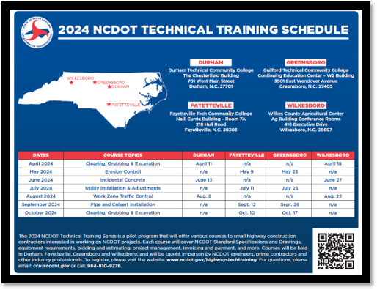
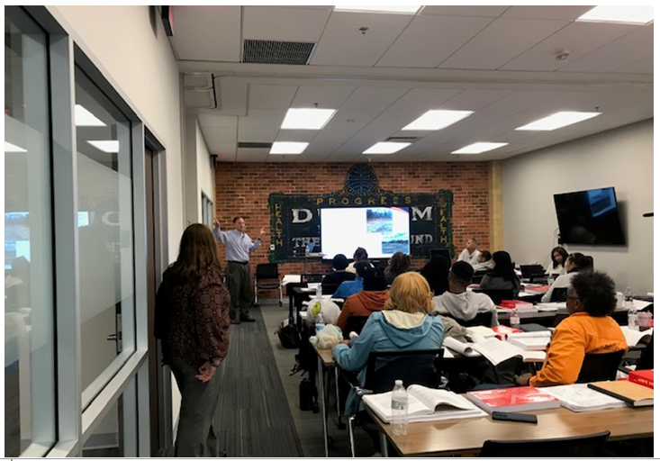
Technical Training Series
The Technical Training Series offers various courses to small highway contractors
Opportunity to learn business tips from a prime contractor (guest speaker).
Each course covers NCDOT Standard Specifications and Drawings, invoicing and payment, and more.
For CY24, we’re offering 6 course topics and 14 sessions at new locations (Durham, Greensboro, Fayetteville, Wilkesboro)

Slide 22
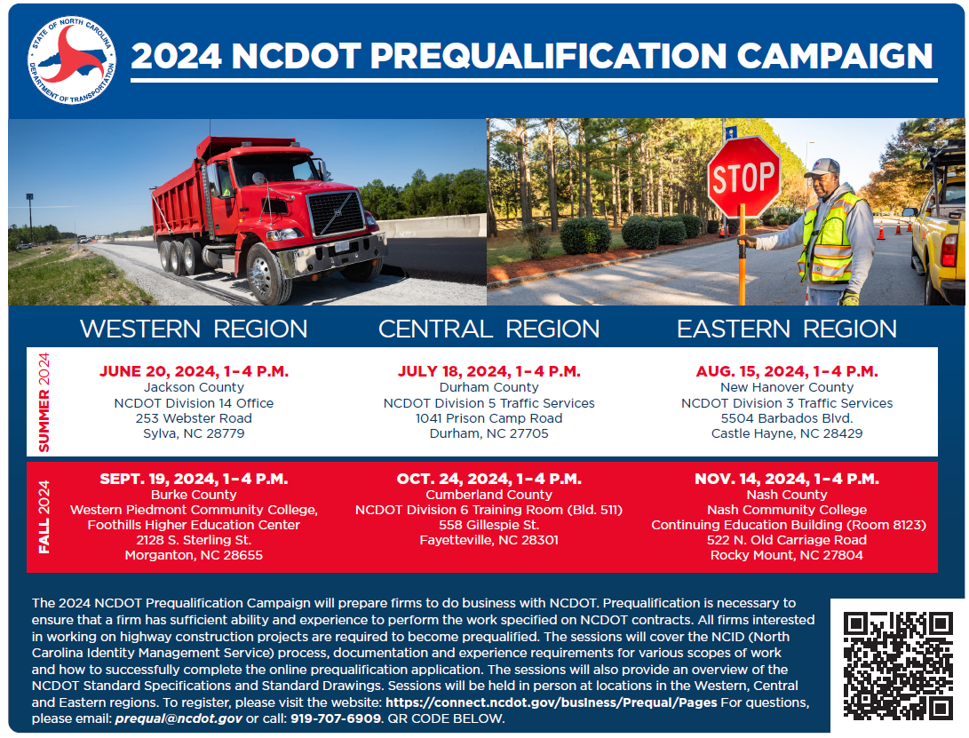
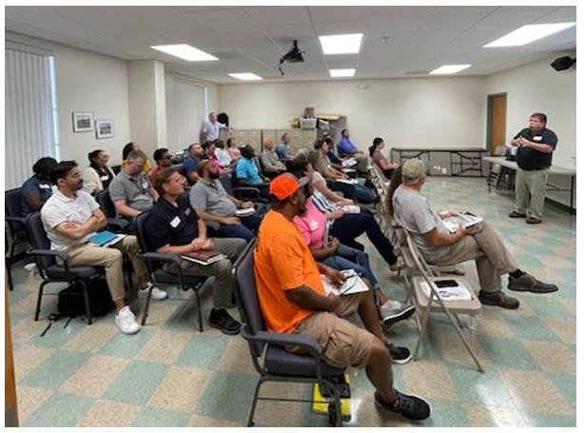
Prequalification Campaign
The Prequalification Campaign will prepare firms to do business with NCDOT as a Bidder, PO Prime or Subcontractor
NCDOT is looking to expand the number of firms that are ready, willing and able to help us meet our project delivery schedule.
For CY24, NCDOT is offering 6 workshops across western, central and eastern regions of the state. Workshops cover the application process, and documentation and experience requirements.

Slide 23
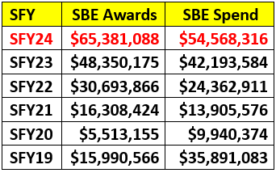
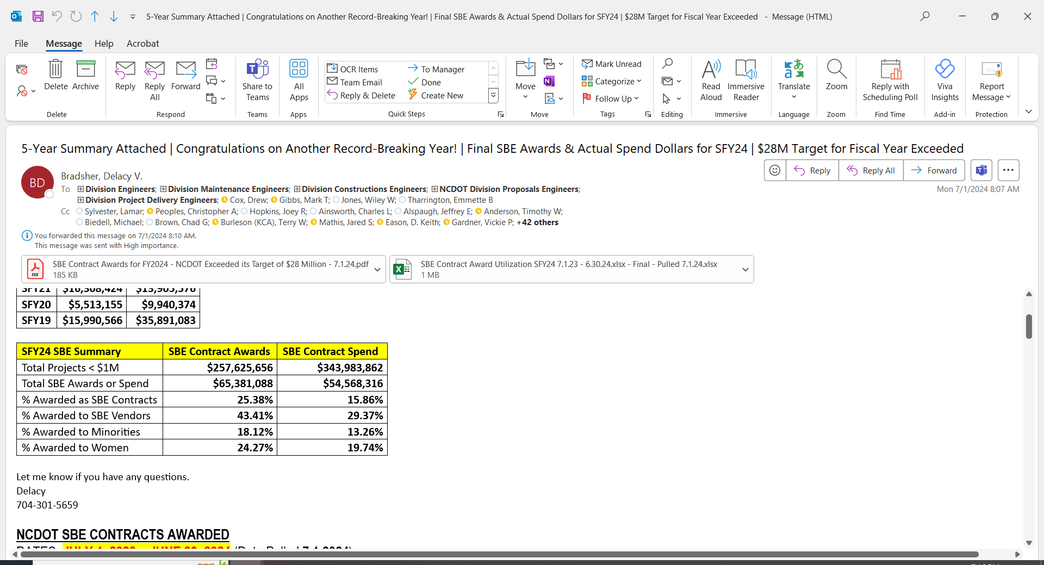
Small Business Enterprises (SBE)
For the third straight year, SBEs had a record year doing work with NCDOT
For FY24, NCDOT awarded about $65.4M to SBEs through contracts under $1M.
The 2024 SBE award ($65.4M) total also represents a 300% increase over the $16.3 million awarded in fiscal year 2021.
This is the first year all 14 highway divisions surpassed their $2M target
$65.4M made up 25% of all contracts under $1M and 43% awarded to SBEs, regardless of contract type.
Notes:
Small Businesses Have Record Year Working for NCDOT
​RALEIGH – For the third straight year, small businesses had a record year doing work for the N.C. Department of Transportation.
NCDOT awarded about $65.4 million to small business enterprises (SBEs) through contracts under $1 million in fiscal year 2024 (ending June 30), marking a 35% increase over the previous record of about $48.4 million in fiscal year 2023 and more than double the target of $28 million.
This is the result of ongoing efforts of NCDOT's Division of Highways and Office of Civil Rights to help introduce small firms to the process of contracting with NCDOT, starting with lower-risk opportunities.
“These numbers are a true reflection of the department's emphasis to utilize more small businesses in our projects," said NCDOT Chief Engineer Lamar Sylvester. “It's a win-win for us. This initiative helps the small businesses position themselves as prequalified subcontractors and prime contractors, which helps NCDOT deliver its highway construction and maintenance programs."
The $65.4 million awarded to small businesses made up a quarter of all contracts under $1 million that were awarded in fiscal year 2024, which was also the first year all 14 Highway Divisions surpassed their traditional targets of having at least $2 million worth of contracts awarded to such firms.
The 2024 SBE award total also represents a 300% increase over the $16.3 million awarded in fiscal year 2021. The record streak began in 2022, with about $30.7 million awarded in SBE contracts. ​

Slide 24
Improving Project Delivery

Slide 25
Focus Areas
Other slide variations are available. Select Insert above and click on the drop menu beside “new slide” to see all the options.
Improving project schedules for more consistent letting
Updating cost estimating practices to accurately reflect market conditions
Strategic selection of alternative delivery projects
Evaluating project size and scope
Training preconstruction project managers
Focusing on quality of preconstruction product
Notes:
We all understand and recognize the inflation that has impacted the highway construction industry. The last 4 years have increased project estimates and costs for NCDOT closely aligning with the National Highway Construction Cost Index.
Through this, we recognized that our traditional cost estimating practices were not nimble enough to respond to the economic changes. We have reviewed and bolstered quality control of quantities and cost estimates being developed by our design groups and estimators.
We defined our policy to update estimates every two years and when projects reach major milestones (alignment defined, right of way plans complete, final design), and before a project enters the 12-month let list.
We are using the bid data, and refreshing unit costs monthly, rather than annually now. The annual updates were not sufficient over the past 4 years with the inflation we have experienced.
And we are better utilizing bid data from similar projects that have been recently let to inform and develop higher quality estimates for projects in the early stages of planning and design.

Slide 26

Creating a More Reliable 12 Month Let List
Other slide variations are available. Select Insert above and click on the drop menu beside “new slide” to see all the options.
15 Month Meeting
  Identify projects that are at risk of not meeting the let date
  Create a more reliable 12 month let list
  Balance monthly lettings
PS&E Turn In Review Meeting
  Confirm complete bidding packages
  Evaluate right of way and utility status
  Confirm status of all permits
  Identifies any areas of concern
Notes:
NCDOT publishes a 12-month let list so contractors are aware of upcoming lettings. There will always be issues beyond our control from permitting agencies, and other external actions, but NCDOT is focused on bringing more reliability to lettings. And we are working to identify and address any issues, before the project enters to the 12 month let list.
To address this, last year, NCDOT created two monthly check-points to allow the Project Manager to demonstrate that the project is on-track for letting.
The first is the 15-month meeting. This meeting is used to confirm that those projects that will enter the 12-month let list in 2-3 months are on track for all design, right of way, utilities, and permits to be in hand and complete for review and advertisement.
The second is the PS&E Turn In Review Meeting. At this meeting, Contract Standards confirms that the project is ready for submittal for reveiw. Again, the expectation is that at turn-in to our Contracts Team, that the project is complete in design, calculations and all required permits, certifications and agreements are in hand. Exceptions for documentation will be rare as we want high quality packages for bidding.
We also use these meetings to work towards a more balanced let across the months as much as possible, so we do not stack lettings in one month. Still working to improve high and low months for central letting.

Slide 27
Federal Grant Update

Slide 28
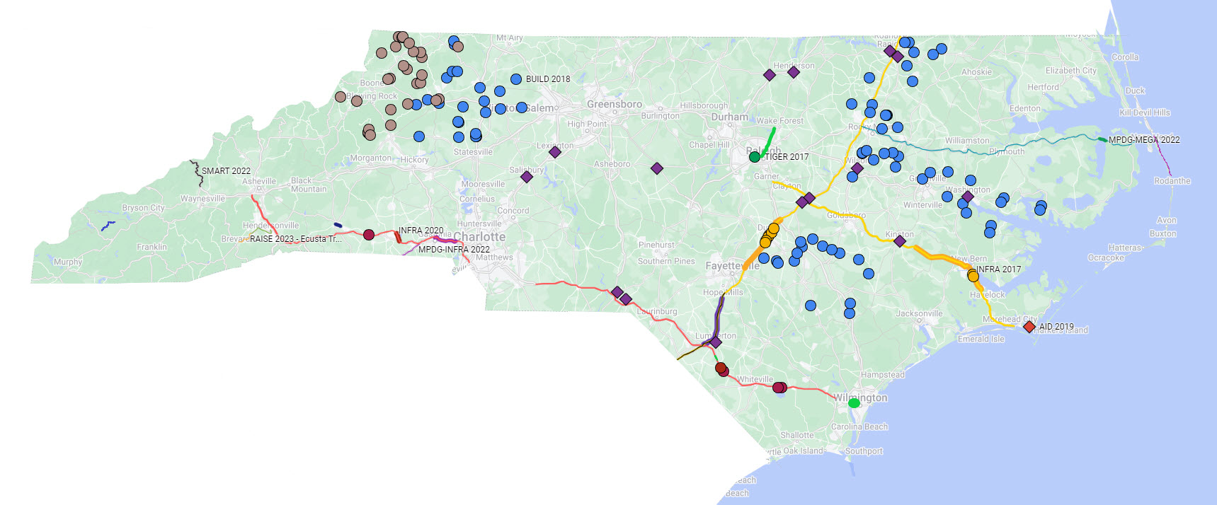
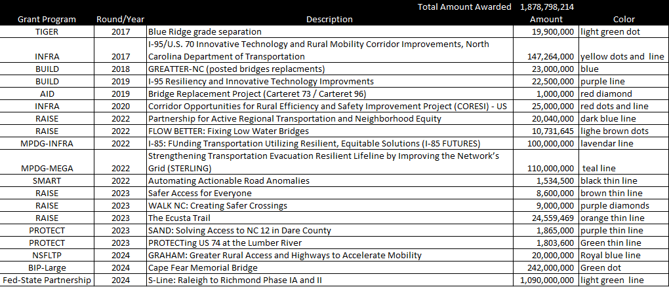
Major Grant Awards since 2017

Slide 29
Future Grant Outlook
Awaiting Announcements on Many Grant Opportunities
  MPDG (INFRA, Mega, Rural)
  Bridge Investment Program (Other than Large & Large)
Actively Working on Current and Upcoming Grant Opportunities
  PROTECT
  Culverts
  RAISE
Monitoring Expected Grant Opportunities over Next Few Years
  IIJA through FFY2026- future of grant funding unclear beyond 2026
  Many NOFOs released funding for the remainder of IIJA this year- likely will be less solicitations in final years of IIJA compared to previous years

Slide 30
Other slide variations are available. Select Insert above and choose “new slide” to see all the options.

